Slide 1
Instruction Set Architecture
Ethan Iwama

Slide 2
The Instruction Set
Instructions | Example | Purpose
Load (LD) | LD r1, [r2] | Loads values from memory to register
Store (ST) | ST [r1],r2 | Stores values from register to memory
Move (MOV) | MOV r1,r2 | MOV r1,3 | Moves values from one register to another, or an immediate value into a register
Add (ADD) | ADD r1,r2 | ADD r1,3 | Adds two register values and stores in the first register, or an immediate value is added to and stored inside a register
Divide (DIV) | DIV r1,r2 | DIV r1,3 | Divides two register values and stores in the first register, or a register value is divided by an immediate value and saved to the register
User Input (INP) | INP r1 | Stores a user input into a register
Print Screen (PRT) | PRT r1 | Prints the number from given register to the terminal
Jump Not Equal (JNE) | JNE r1,r2 | Jumps to a previously found loop start address if the registers specified are not equal
8 total instructions
3-bit opcode encoding
First register mentioned is always where values get stored
Brackets indicate data segment addresses stored in register
Immediate values are 8 bits

Slide 3
Instruction Encoding
Instructions | Opcode | Output Register | Input Register | Extra
Load (LD) | 0 0 0 | X X X | X X X or 1 1 X | X X X X X X X
Store (ST) | 0 0 1 | X X X | X X X or 1 1 X | X X X X X X X
Move (MOV) | 0 1 0 | X X X | X X X or 1 1 X | X X X X X X X
Add (ADD) | 0 1 1 | X X X | X X X or 1 1 X | X X X X X X X
Divide (DIV) | 1 0 0 | X X X | X X X or 1 1 X | X X X X X X X
User Input (INP) | 1 0 1 | X X X | 0 0 0 | 0 0 0 0 0 0 0
Print Screen (PRT) | 1 1 0 | X X X | 0 0 0 | 0 0 0 0 0 0 0
Jump Not Equal (JNE) | 1 1 1 | X X X | X X X | 0 0 0 0 0 0 0
All instructions are 16 bits long
Instructions separated into opcode + output + input + extra
Opcode gives instruction
Output register is where the value will be stored
Input register is the secondary register
Output/Input is swapped only for ST
Registers are designated 000-111 for r0-r7
No instructions are allowed to access r6 or r7
If an immediate value is used, first two digits of input register become 11 and the last 8 bits of the instruction are used for immediate
Extra section gets zeroed out when immediate is not being used

Slide 4
Instruction Encoding
Instructions | Opcode | Output Register | Input Register | Extra
Load (LD) | 0 0 0 | X X X | X X X or 1 1 X | X X X X X X X
Store (ST) | 0 0 1 | X X X | X X X or 1 1 X | X X X X X X X
Move (MOV) | 0 1 0 | X X X | X X X or 1 1 X | X X X X X X X
Add (ADD) | 0 1 1 | X X X | X X X or 1 1 X | X X X X X X X
Divide (DIV) | 1 0 0 | X X X | X X X or 1 1 X | X X X X X X X
User Input (INP) | 1 0 1 | X X X | 0 0 0 | 0 0 0 0 0 0 0
Print Screen (PRT) | 1 1 0 | X X X | 0 0 0 | 0 0 0 0 0 0 0
Jump Not Equal (JNE) | 1 1 1 | X X X | X X X | 0 0 0 0 0 0 0
To designate the start of a loop for JNE, a colon is placed on the line preceding the starting line of the loop
Text can be used before the colon, e.g. “loop:”
The colon will always send an instruction of all 1s
When the colon instruction is read, the processor will save the pointer value for the loop start instruction in register r6

Slide 5
Average 8 Program
MOV r0,0 ; Initialize the first seven locations of the data segment with 0
ST [0000],r0
ST [0001],r0
ST [0002],r0
ST [0003],r0
ST [0004],r0
ST [0005],r0
ST [0006],r0
;
;
MOV r4,0 ; Average pointer
MOV r5,7 ; Store Pointer
;
;
loop: ; Next line is start line of loop
INP r0 ; This register is now accepting user input
ST [r5],r0 ; Store the value in data segment
ADD r5,1 ; Increment r5 for next store address in DS
MOV r1,r4 ; Load the current average pointer location to r1
LD r2,[r1] ; Load values to r2 and r3 and add (2/8 summed)
ADD r1,1
LD r3,[r1]
ADD r1,1
ADD r2,r3
LD r3,[r1] ; Load new value to r3 and add to sum (3/8 summed)
ADD r1,1
ADD r2,r3
LD r3,[r1] ; (4/8 summed)
ADD r1,1
ADD r2,r3
LD r3,[r1] ; (5/8 summed)
ADD r1,1
ADD r2,r3
LD r3,[r1] ; (6/8 summed)
ADD r1,1
ADD r2,r3
LD r3,[r1] ; (7/8 summed)
ADD r1,1
ADD r2,r3
LD r3,[r1] ; (8/8 summed)
ADD r2,r3
ADD r1,1
;
;
MOV r3,8
DIV r2,r3 ; Divide the sum by 8
PRT r2 ; Print average to screen
;
;
ADD r4,1
ADD r1,1
JNE r1,r5
Program written in the instruction set to take the moving average of 8 values
Accepts user values
It averages the most recent 8 values in memory
Code size is 44 lines
Initializes the first 7 addresses in memory with 0 for the first user value to give an average
Has an average pointer to know where to start the next average in memory
Has a store pointer to know the next place to store a user value in memory
“loop:” used to designate instruction 11 (INP) as the start of the JNE loop
Program loops when r1 (current average pointer location) and r5 (store pointer) are not equal; they can only be equal at DS address 0xFFFF

Slide 6
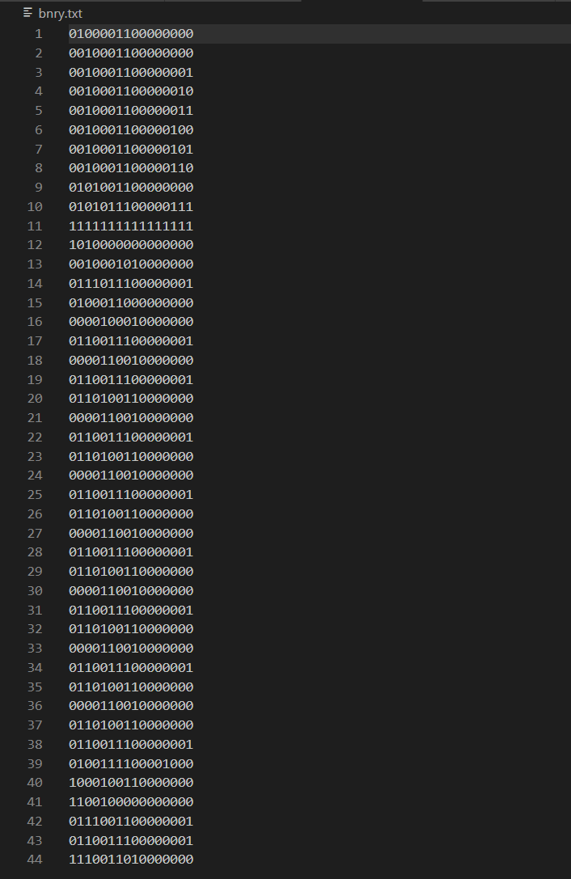
Assembler Program
Program written in Python to assemble the instruction set code into machine code
Takes in a plain text file with assembly code and outputs a text file with the binary machine code
Code size of 221 lines
Was tested using the avg8.asm program file; all instructions in the instruction set were tested and encoded
The assembler was built with scalability in mind
Binary output of avg8 shown left

Slide 7
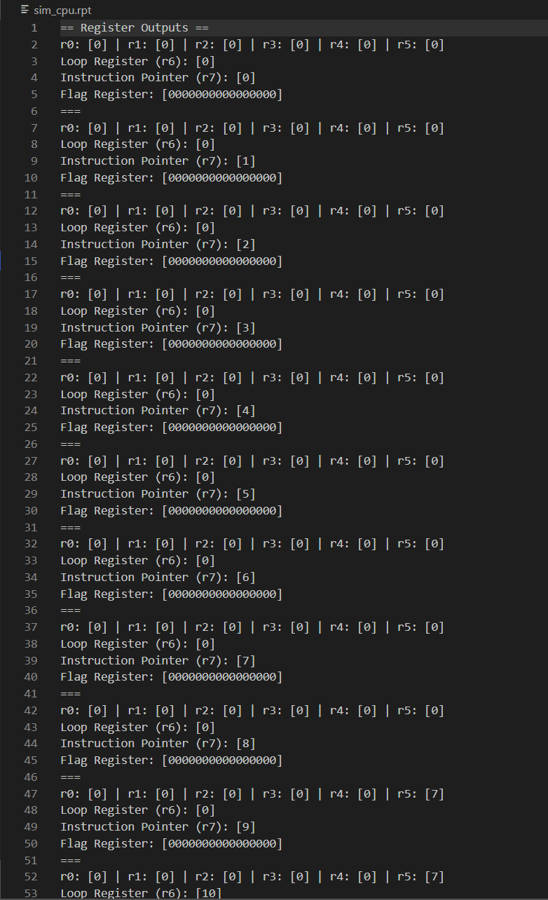
Simulator Program
Program written in Python to execute the machine code output by the assembler
Takes in a plain text file with machine code and outputs a report file with the status of every register in the simulator after every instruction
Code size of 1409 lines
Was tested using the avg8.asm machine code from the assembler; all instructions in the instruction set were tested and functioned
6 general purpose registers (r0-r5)
1 loop register (r6)
1 instruction pointer (r7)
1 flag register
Snippet of report file shown left

Slide 8
Simulator Program
The loop register holds the location of the first instruction inside of the loop
The instruction pointer points to the next instruction
The flag register only has 4 flags implemented (OF, SF, ZF, PF)
Overflow is 1 when a sum or quotient is more than 16 bits
Sign is 1 when a sum or quotient is less than 0
Zero is 1 when sum or quotient is equal to 0
Parity is 1 when the number of 1s in a binary sum or quotient is even

Slide 9
Simulator Program
The registers all hold the values as decimal integers in the program
Flag register is the exception, holding an array of bits that flip on or off depending on the flag
No sums or quotients can exceed the max register value of 0xFFFF
Bitwise operations were used for the division instruction

Slide 10
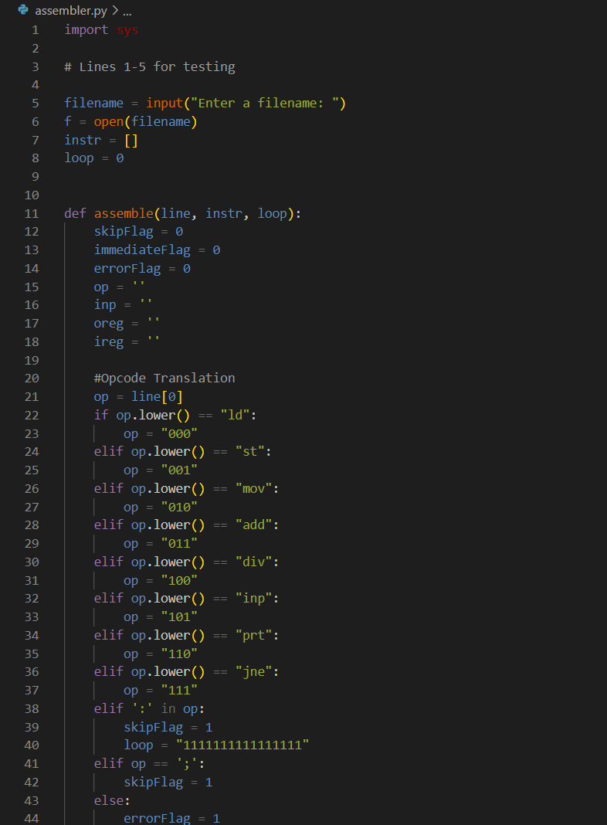
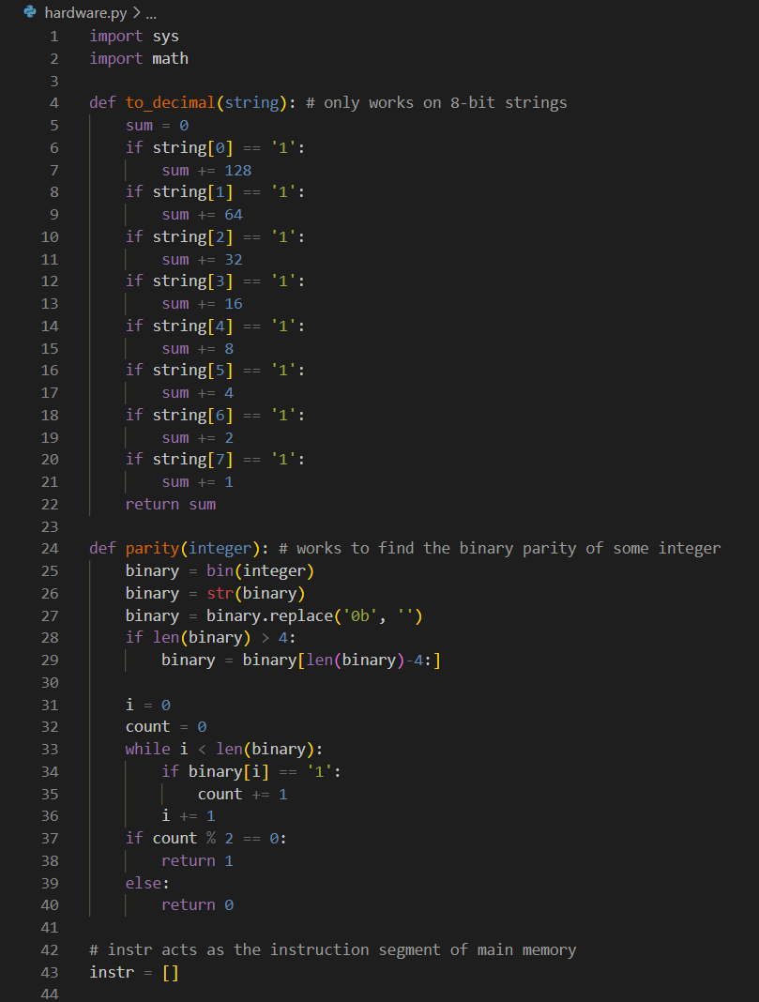
Conclusions
16-bit instructions are limiting
Registers are part of the foundation of computer architecture
Computers have a complicated but clever way of translating humanish instructions to machine code
High-level languages make coding larger scale programs significantly easier

